Slide 1

Chapter 8 Climate and Climate Change

Slide 2

Chapter 8
Weather
Climate
Short Term
Long Term
30 years or more

Slide 3

Climate Classification
Köppen climate classification system
Based on a database of annual and monthly average temperature and precipitation
Four of five major groups classified by temperature
Fifth group classified by precipitation
The five groups subdivided further based on temperature and precipitation relationships
Köppen letter code system
Three letters; first describes group, second describes precipitation, third describes temperature
Climographs

Slide 4
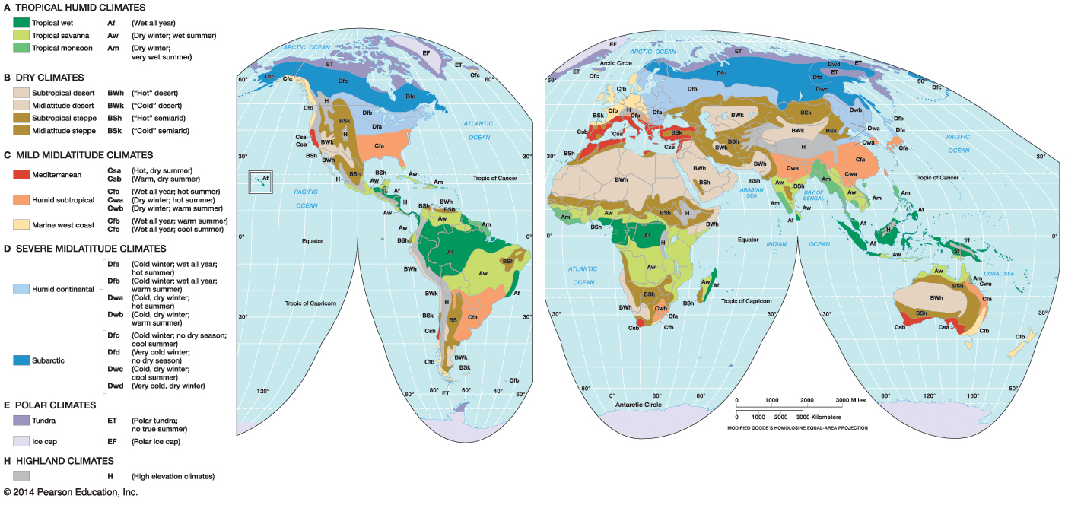

Notes:
Chapter 8, Figure 8.3 Labeled

Slide 5
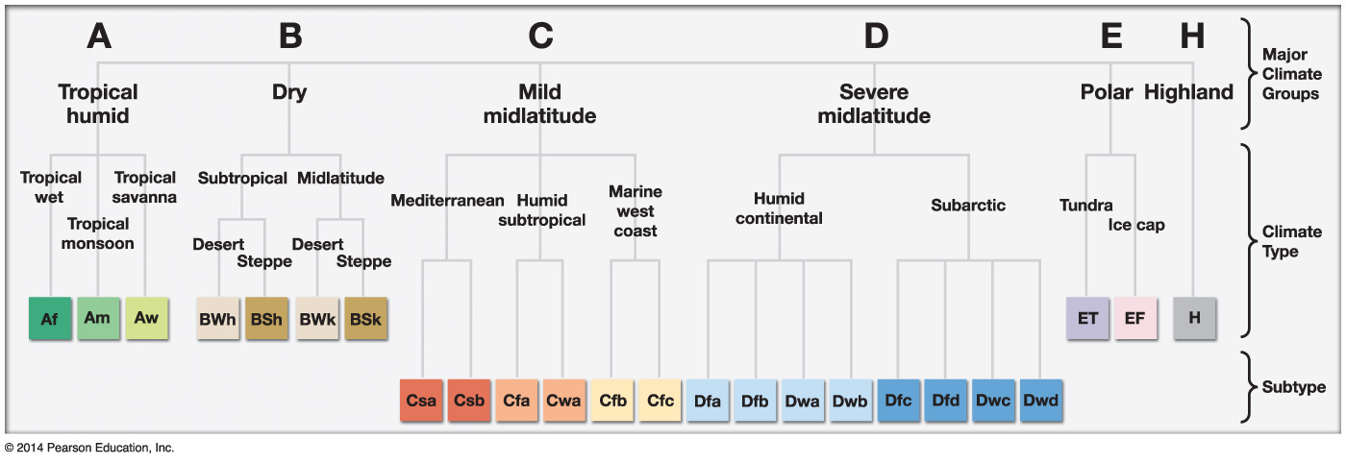

Notes:
Chapter 8, Figure 8.2 Labeled

Slide 6
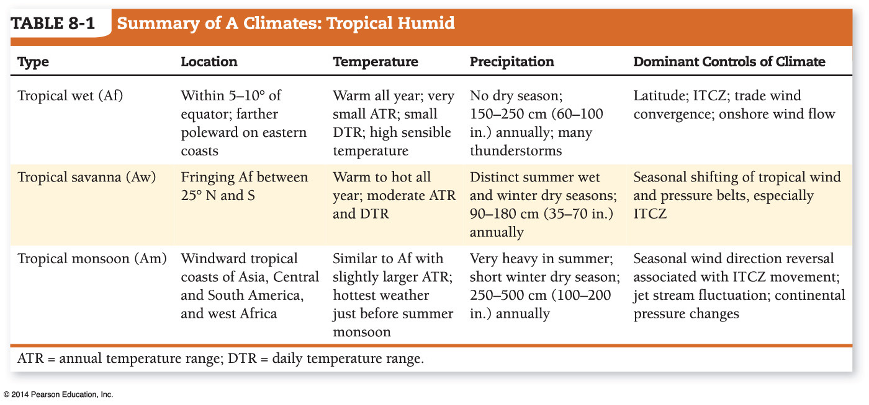

Notes:
Chapter 8, Table 8.1 Labeled

Slide 7
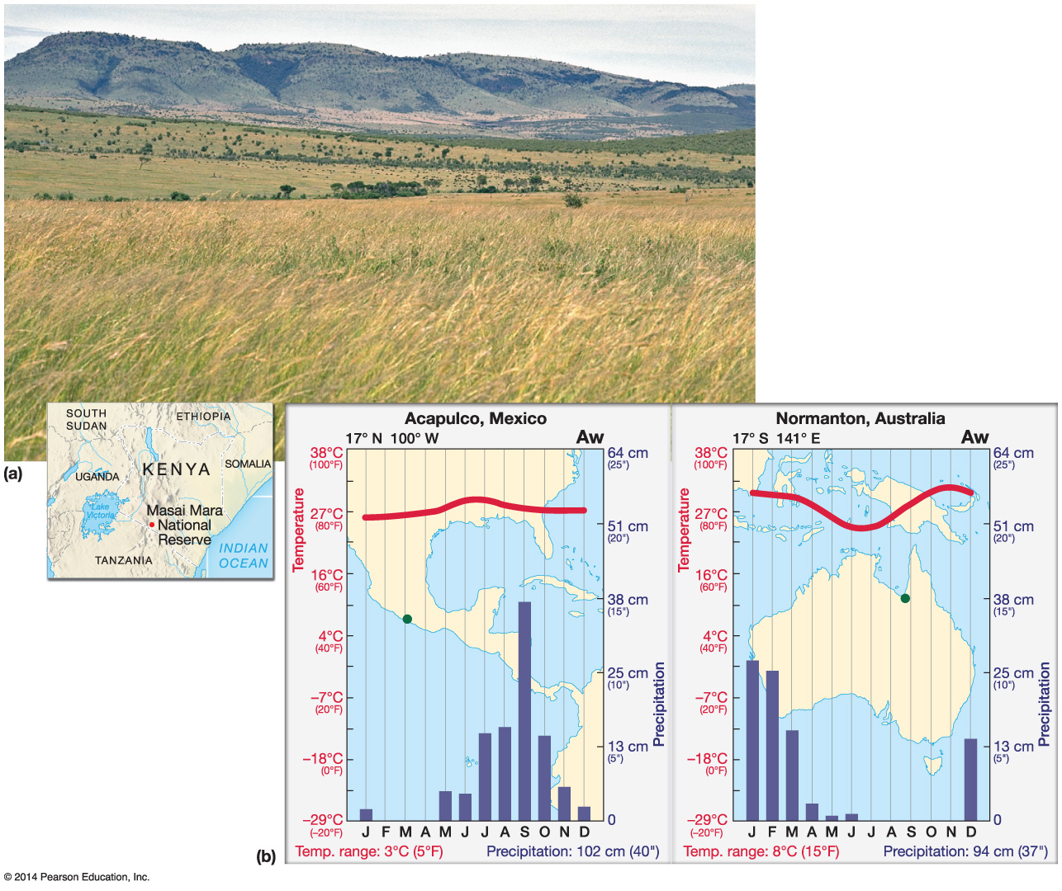

Notes:
Chapter 8, Figure 8.8 Labeled

Slide 8
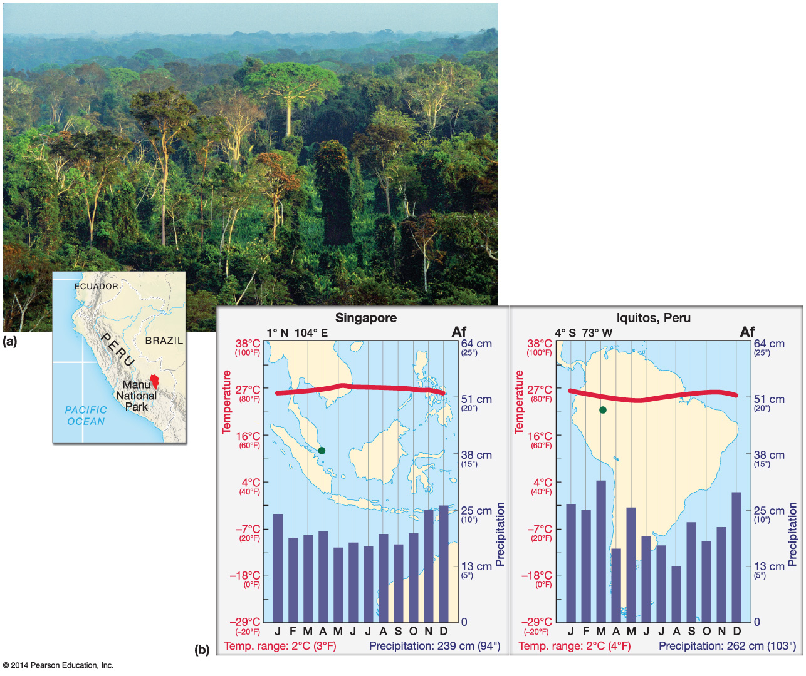

Notes:
Chapter 8, Figure 8.6 Labeled

Slide 9
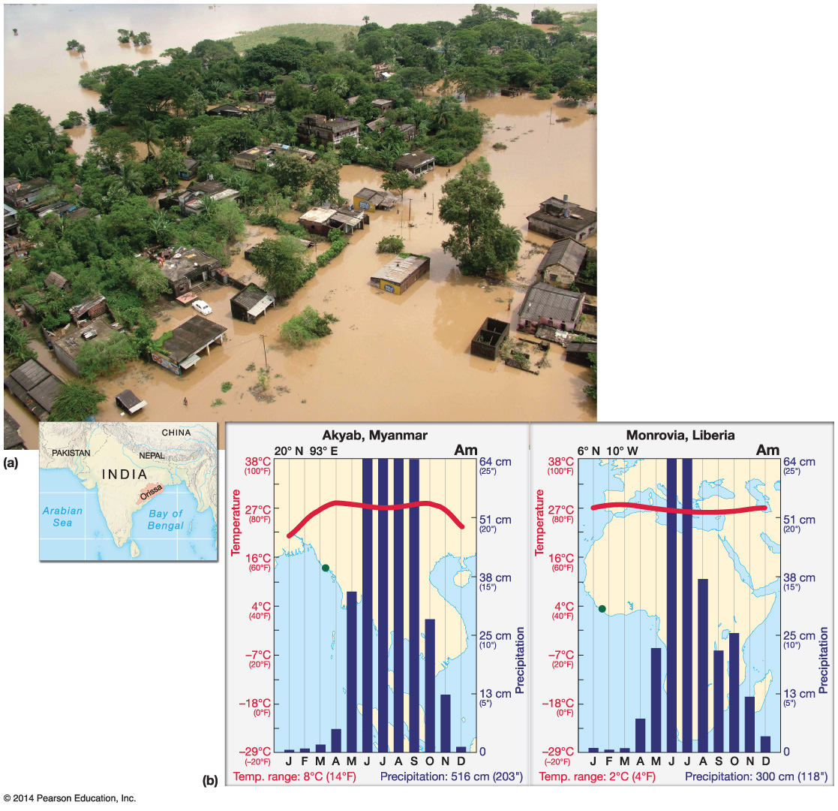

Notes:
Chapter 8, Figure 8.10 Labeled

Slide 10
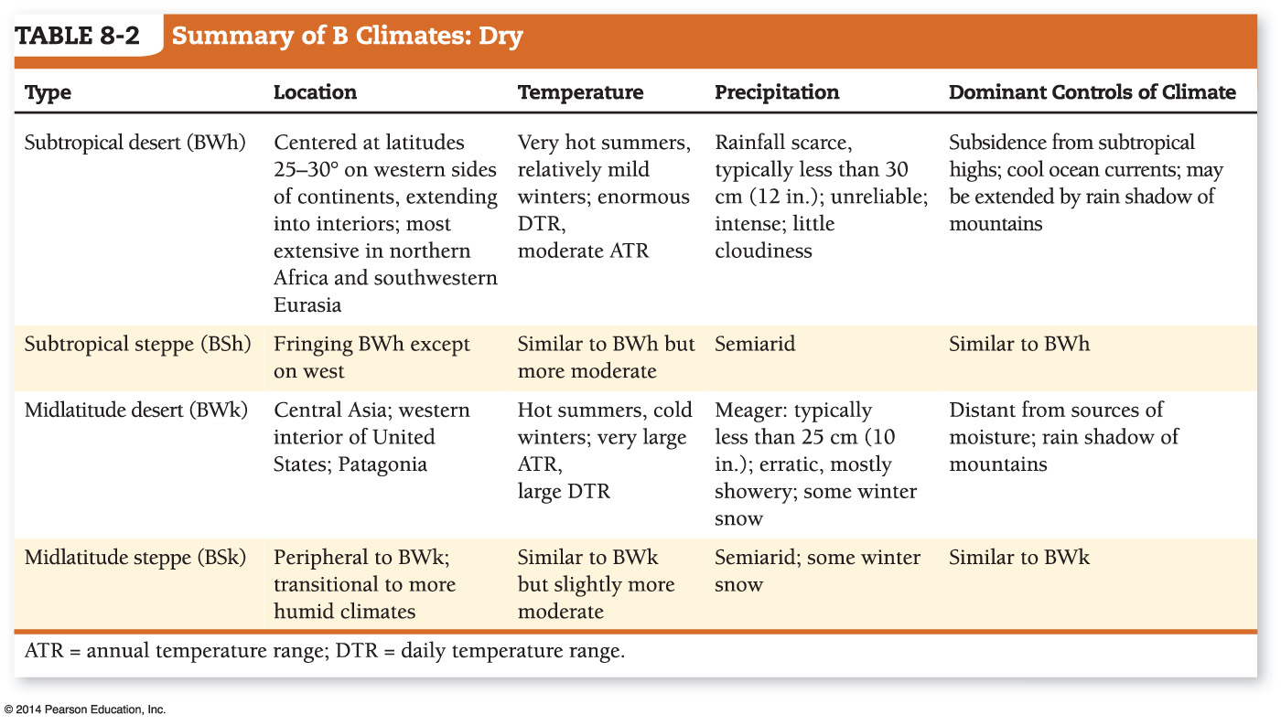

Notes:
Chapter 8, Table 8.2 Labeled

Slide 11
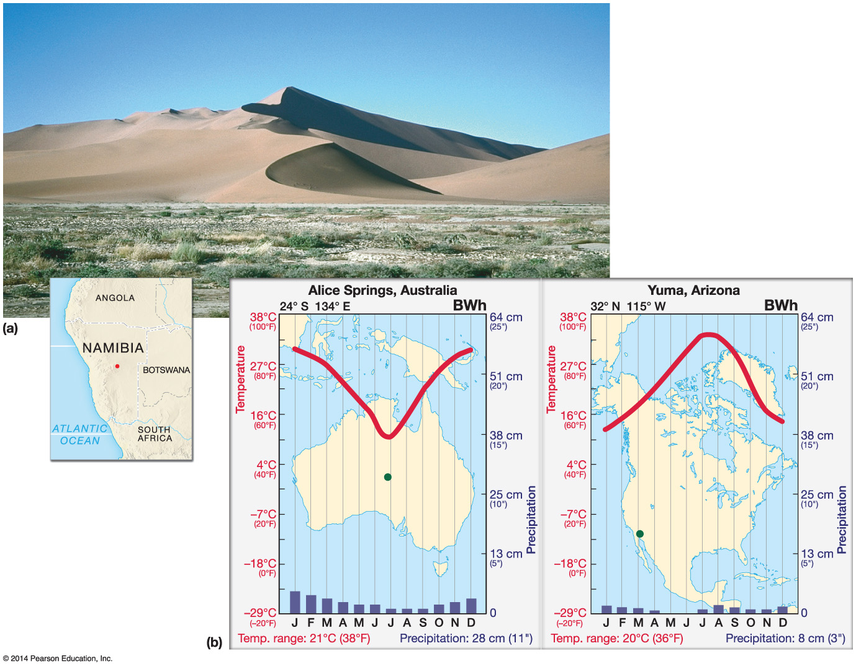

Notes:
Chapter 8, Figure 8.14 Labeled

Slide 12
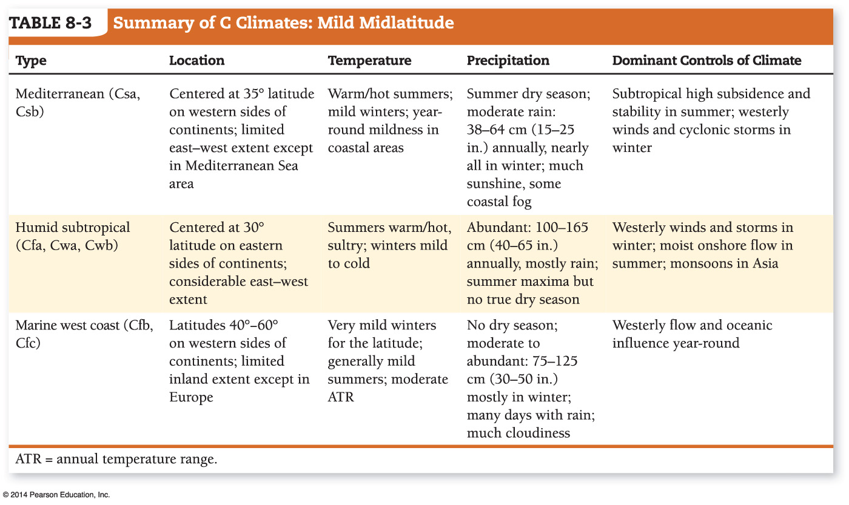

Notes:
Chapter 8, Table 8.3 Labeled

Slide 13
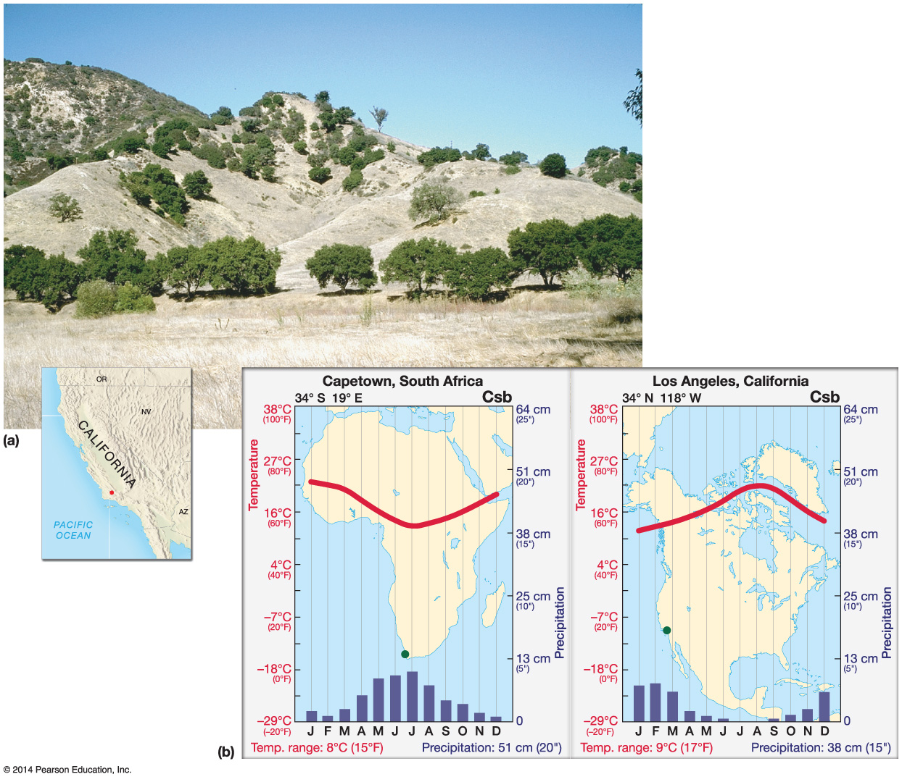

Notes:
Chapter 8, Figure 8.21 Labeled

Slide 14
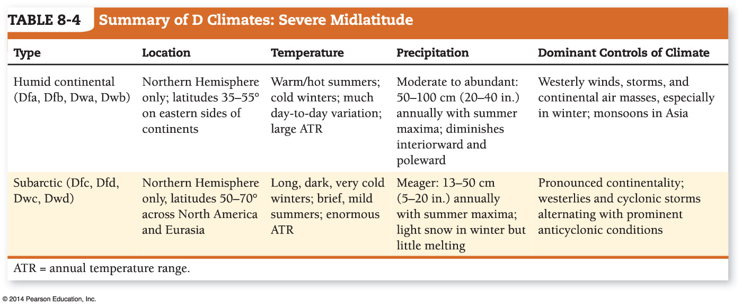

Notes:
Chapter 8, Table 8.4 Labeled

Slide 15
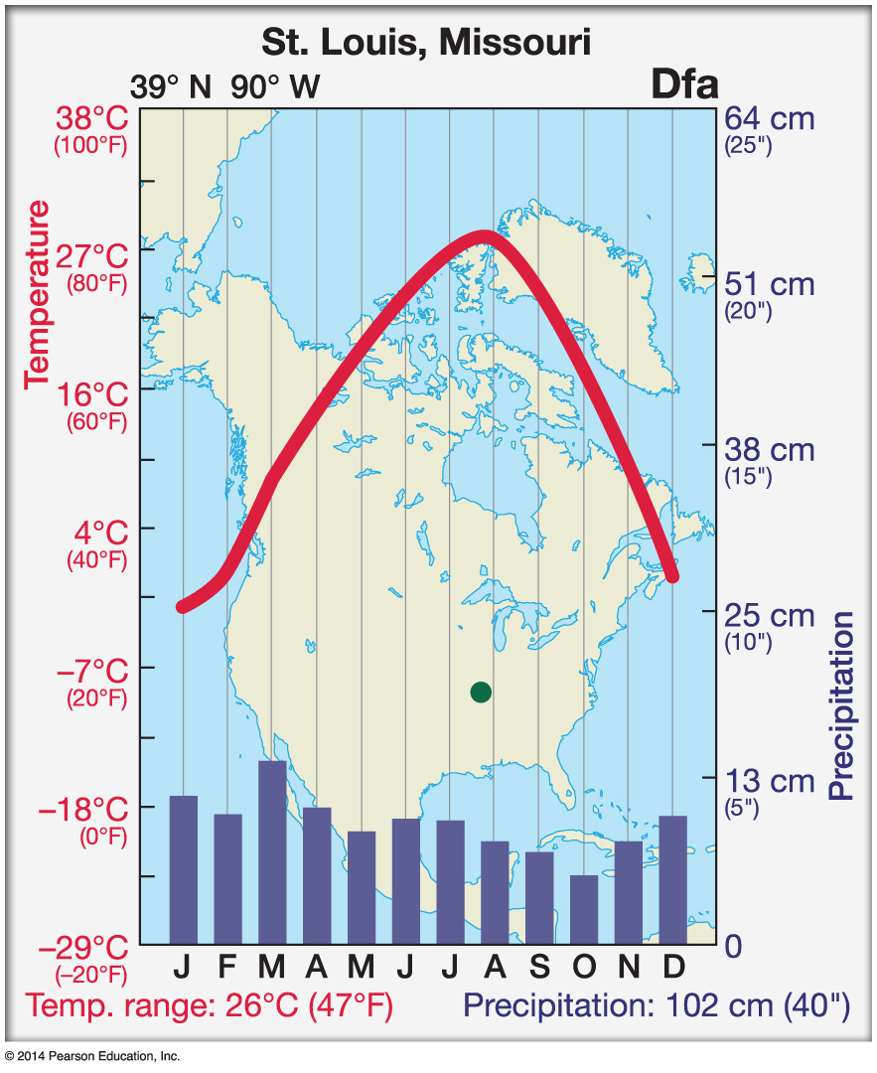

Notes:
Chapter 8, Figure 8.4 Labeled

Slide 16
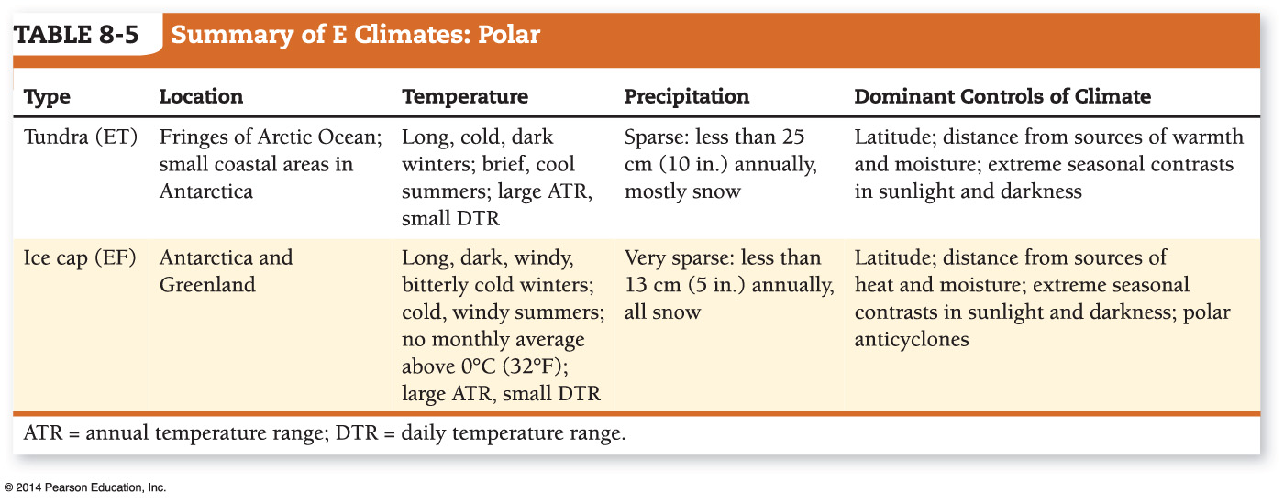

Notes:
Chapter 8, Table 8.5 Labeled

Slide 17
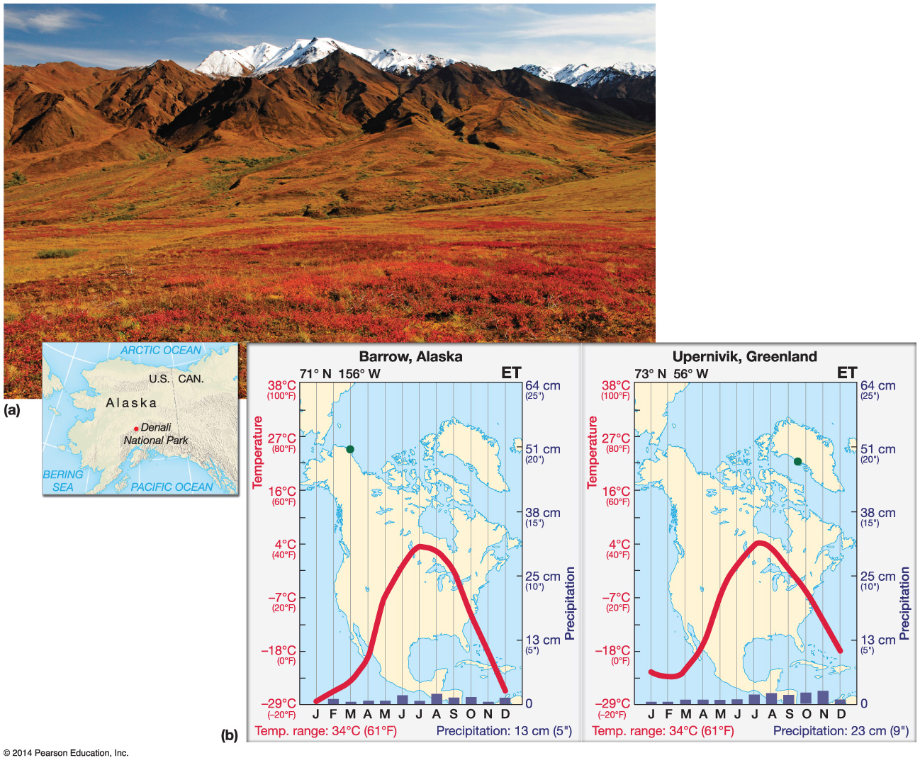

Notes:
Chapter 8, Figure 8.30 Labeled

Slide 18

Climate change or global warming
International Panel on Climate Change (IPCC)
2001
“The balance of evidence suggests that there is a discernible human influence on global climate.”

Slide 19
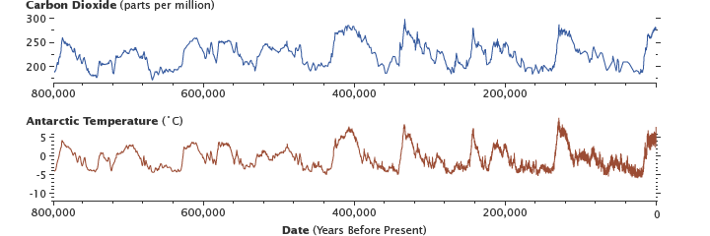

Carbon Dioxide and Temperature
Other proxy methods
Notes:
Source nasa

Slide 20
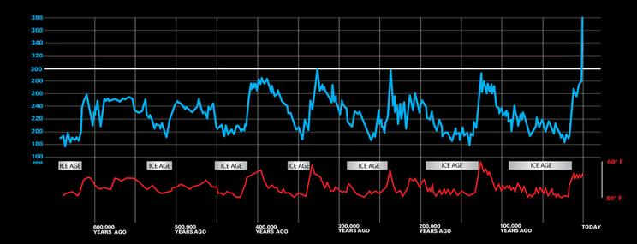

Ice Ages

Slide 21

Consequences of climate change
Sea level change- Coastal erosion, flooding, loss of wetlands, increased salinity of groundwater- Some islands underwater- Maldives
IPCC anticipates a rise of 48 to 79 cm by 2100. Such a rise will be particularly problematic for the 25% of the global population that live within only 1.1 meters of sea level.
Droughts and agriculture production
Increased vector-born diseases- Zika, malaria
Increase in severity of hurricanes; Fires
Himalayan water tower- Other areas similar results- Andes
Climate change- Wind systems
Notes:
Maldives- tragedy of commons. Poor versus wealthy
Vector born- mosquitos, less cold can survive winter.
Himalayan water tower- China- depends on this water

Slide 22

Solutions
Environment’s ability to absorb carbon, also known as carbon sequestration.
Plant more trees – Carbon offset programs
Inject into ground
Preserve forest- Absorb carbon dioxide and release of carbon dioxide from fires
Irrigation
Emission trading- problems in U.S. depends on political party and economics—More success at different scale- states or cities
International agreements- Kyoto agreement-
emission trading- technology transfer- More bang for the buck
Protection of tropical rainforest
Notes:
Carbon offset- problems – but could enforce with remote sensing
Deindustralization of Russia

Slide 23

Climate Change
Activities

